Slide 1
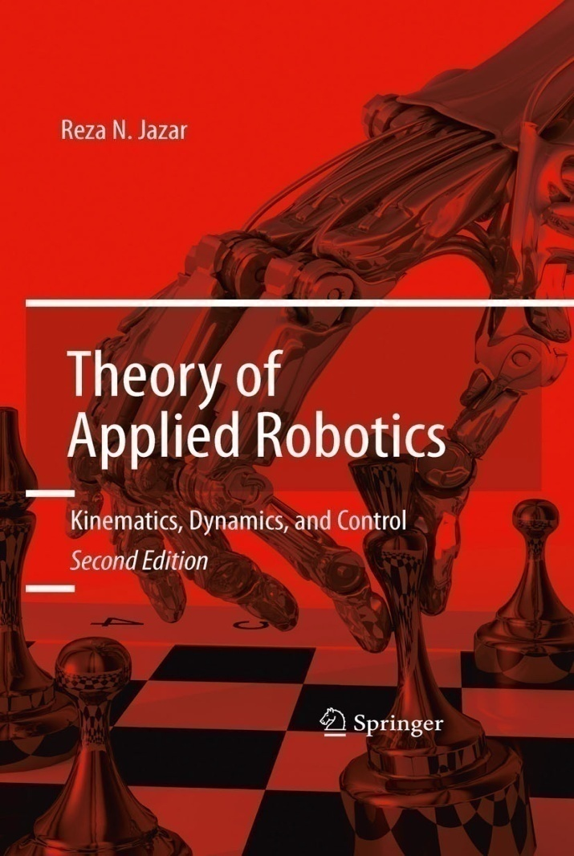
California State University, San Bernardino
School of Computer Science and Engineering
CSE 541 Robotics and Control
Chap. 1 Introduction
Edited by Haiyan Qiao

Slide 2
Chapter 1. Introduction
Robots : first adopted by Asimov in 1941 through his short science fiction story, Runaround.
Based on the Robotics Institute of America(RIA) definition: “ A robot is a reprogrammable multifunctional manipulator designed to move materials, parts, tools, or specialized devices through variable programmed motions for the performance of a variety of tasks.”
The engineering point of view: Robots are complex, versatile, ( intelligent ) devices that contain a mechanical structure, a sensory system, and an automatic control system on the results of research in mechanics, electric, electronics, automatic control, mathematics, and computer sciences.

Slide 3
California State University, San Bernardino
School of Computer Science and Engineering
Isaace Asimov proposed the four refined laws of “robotics” to potect us from intelligent generations of robots:
- Law Zero: A robot may not injure humanity, or, through inaction, allow humanity to come to harm.
- Law One: A robot may not injure a human being, or, through inaction, allow a human being to come to harm, unless this would violate a higher order law.
Law Two: A robot must obey orders given it by human beings, except where such orders would conflict with a higher order law.
Law Three: A robot must protect its own existence as long as such protection does not conflict with a higher order law.

Slide 4
1.1. Historical Development
The first industrial modern robots were the Unimates, made by J. Engelberger in the early 60s. Engelberger has been called the father of robotics.
- In the research community the first automata were probably Grey walter’s machina(1940s) and the Johns Hopkins beast. The first programmable robot was designed by George Devol in 1954.
- In 1959 the first commercially available robot appeared on the market. Robotic manipulators were used in industries after 1960, and saw sky rocketing growth in 1980s.
Robots appeared as a result of combination two technologies: teleoperators, and computer numerical control (CNC) of milling machines.
It is claimed that robots appearred to perform in 3D3H environments. 3D3H means dull, dirty, dangerous, hot, heavy and hazardous.

Slide 5
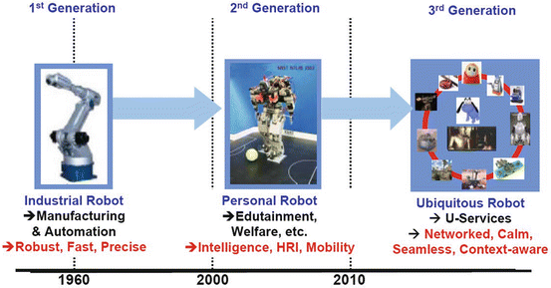
From Roboethics:SpringerLink

Slide 6
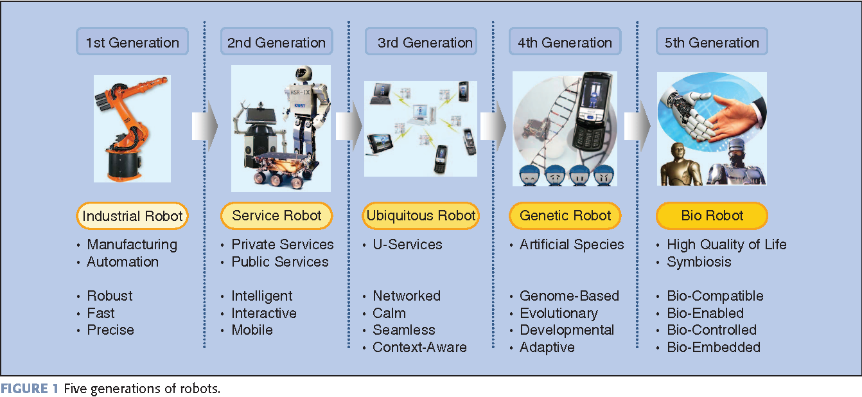
From “Intelligence Technology for Robots That Think [Application Notes]”

Slide 7
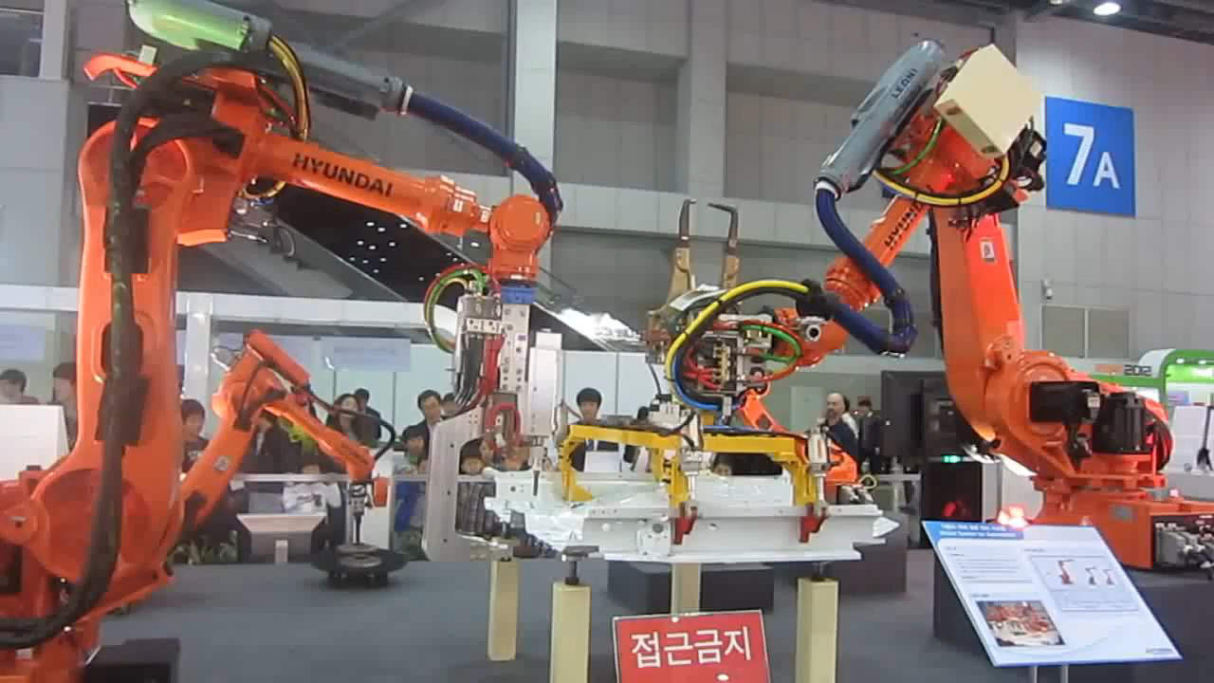
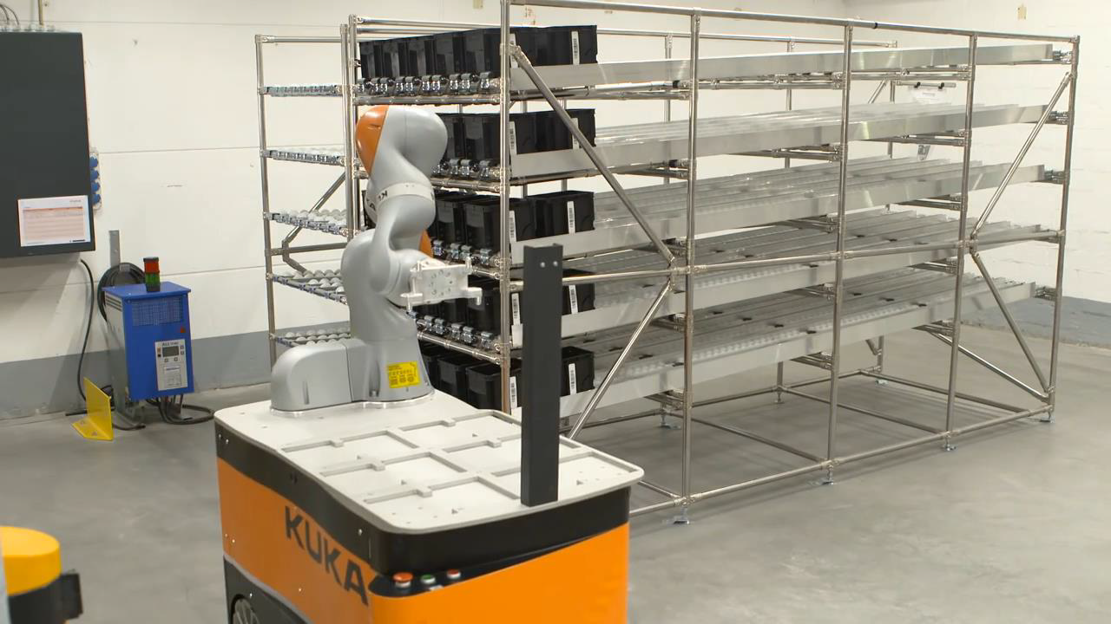
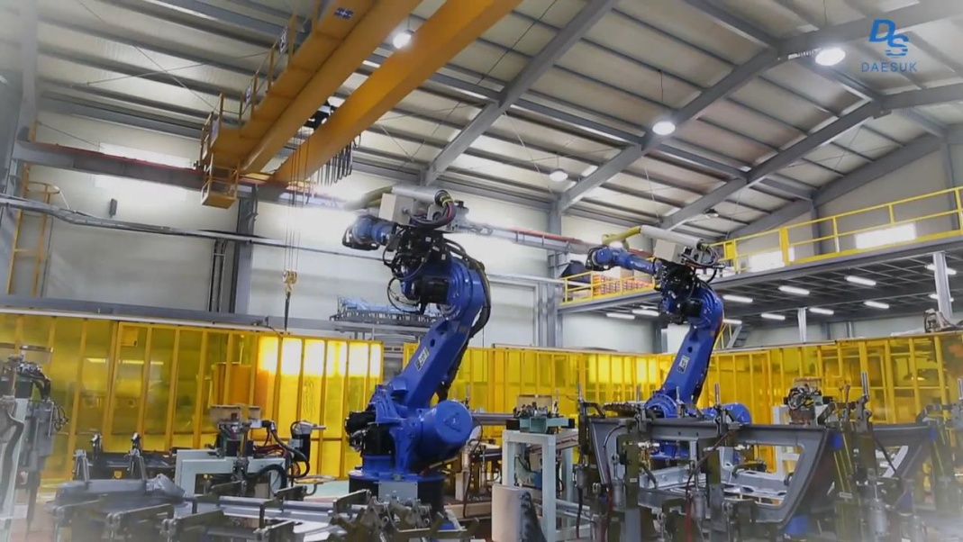
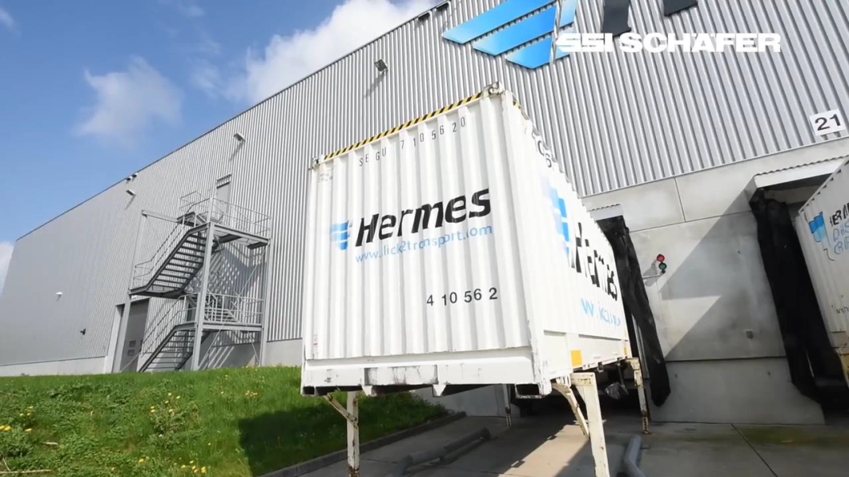
Industrial Robots
Robots to handle the heavy weight
Mobile Manipulator
Welding Robots
Automated Guided Vehicles

Slide 8
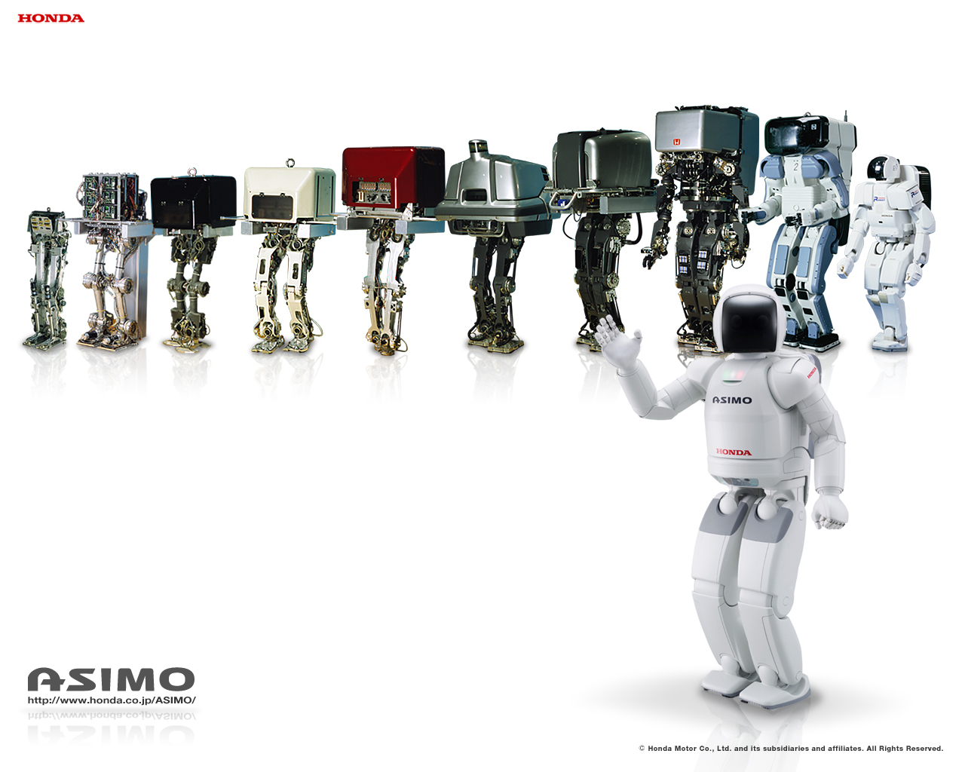
Humanoid Asimo
Humanoid Asimo
Company : Honda
1982- 2018

Slide 9
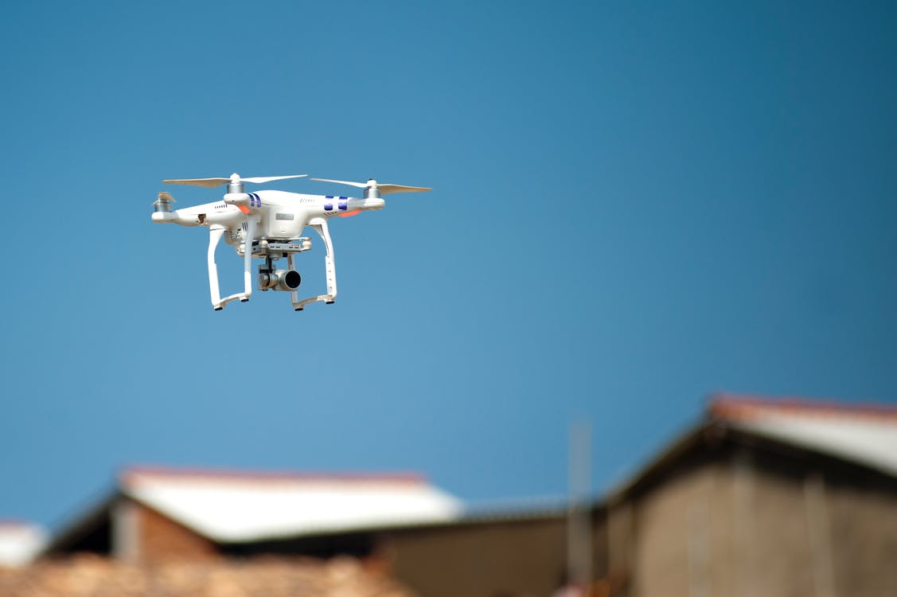
Robot airplane

Slide 10
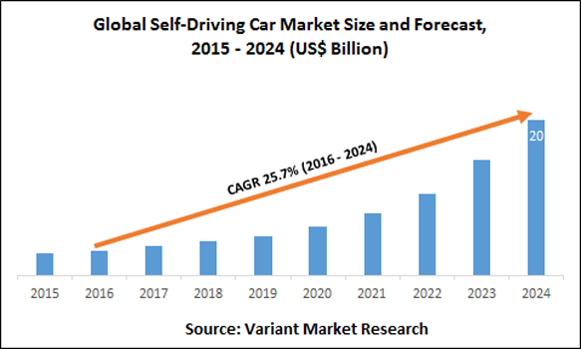
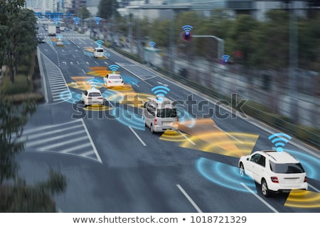
Robot car

Slide 11
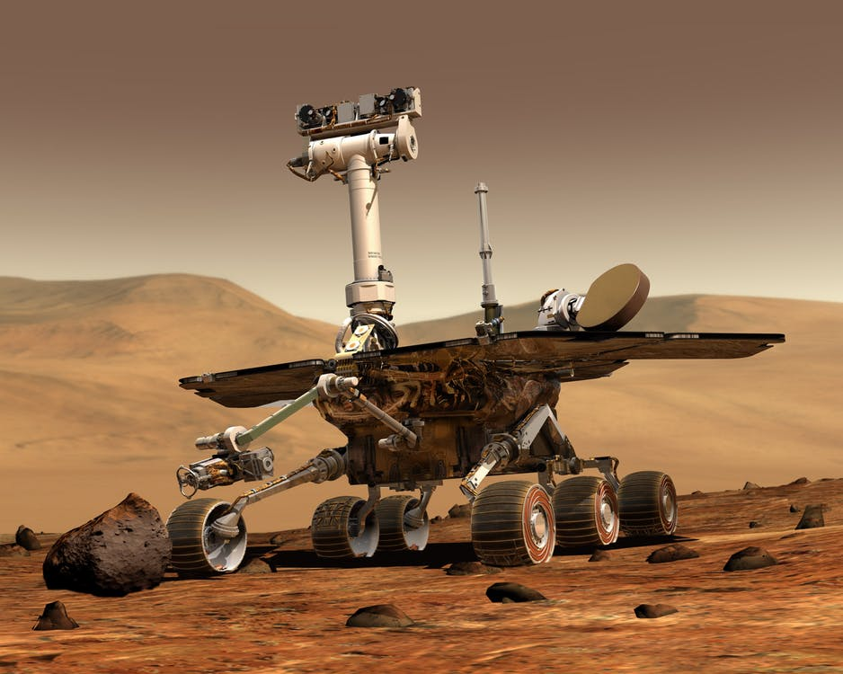
Space Robot

Slide 12
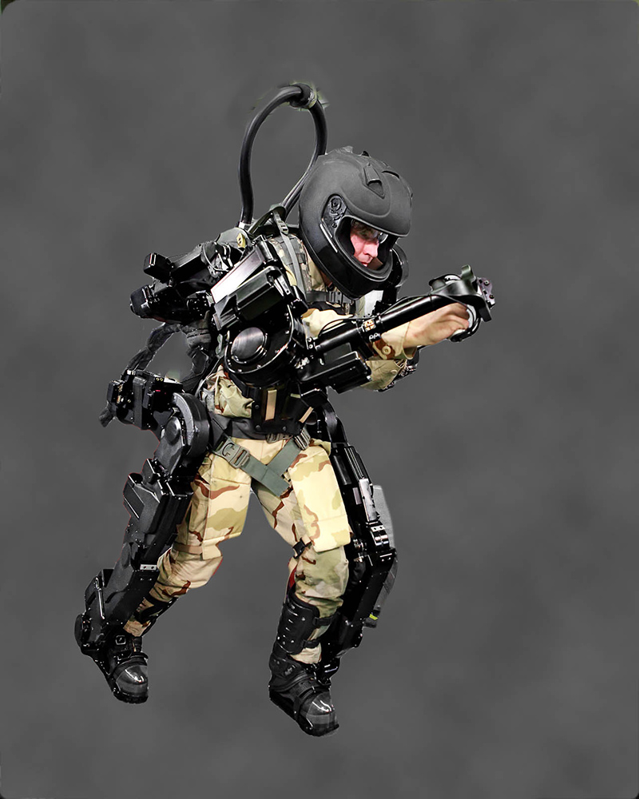
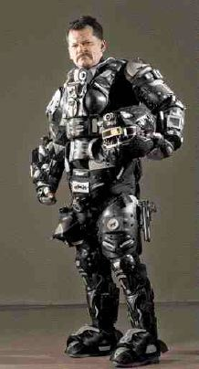
Exoskeleton
Notes:
Its design aims to provide back support, sense the user's motion, and send a signal to motors which manage the gears.
Exoskeleton robots are a unique form of professional service robots, deployed in a wide range of applications, intended to mimic, augment or enhance the body's own movements. These robots provide essential support for human motion, with potential uses ranging from consumer products to military deployment.

Slide 13
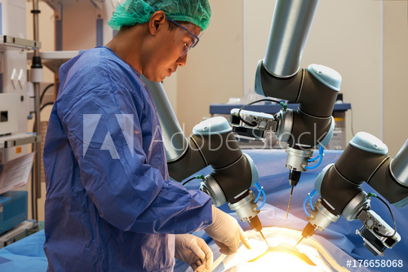
Surgical Robot
Notes:
Widely used in eye surgery and prostate surgeries. Robotic surgery allows surgeons to perform complex surgical tasks through tiny incisions using robotic technology.

Slide 14
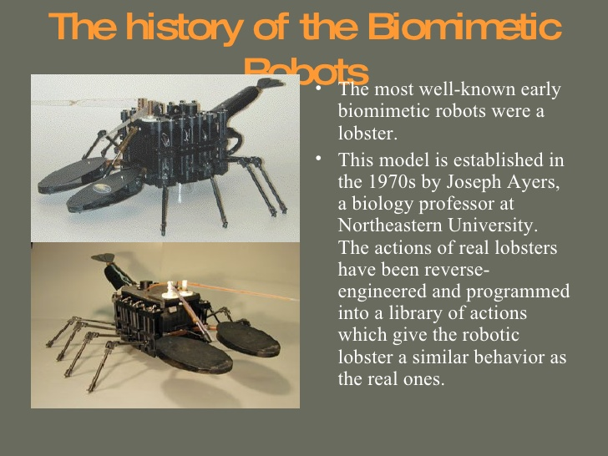
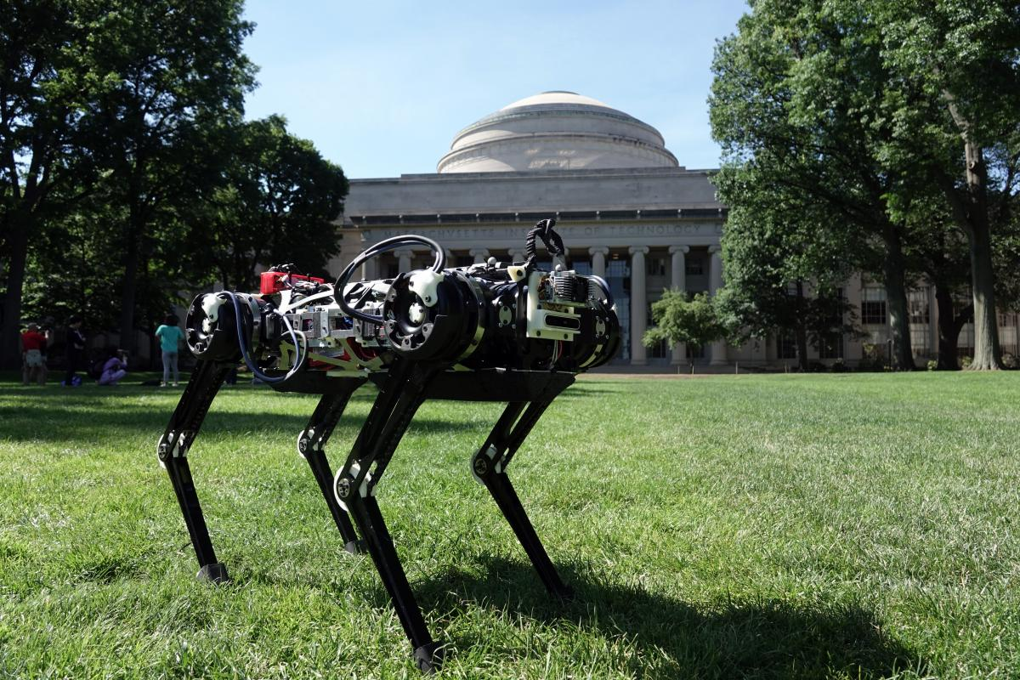
Bio-mimetic Robot

Slide 15
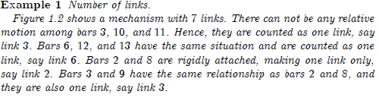
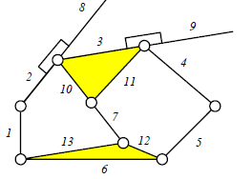
1.2. Robot Components
- Robotic manipulators are kinematically composed of links connected by
Joints to form a kinematic chain. However, a robot as a system, consists
of a manipulator, a wrist, an end-effector, actuators, sensors, controllers,
Processors, and software.
1.2.1 Link
The individual rigid bodies that make up a robot are called links( arms)

Slide 16
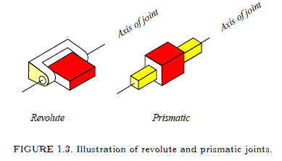
1.2. 2. Joints
Two links are connected by contact at a joint where their relative motion
Can be expressed by a single coordinate. Joints are typically revolute (ro-
tary) or prismatic (translatory)

Slide 17
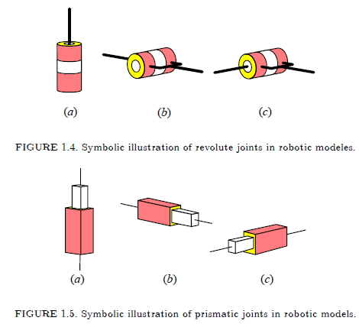
1.2. 2. Joints
The value of the single coordinate describing the relative position of two
connected links at a joint is called joint coordinate or joint variable
It is an angle for a revolute joint, and a distance for a prismatic joint.
Active joints are usually prismatic or revolute , however, passive joints may be any of the lower pair joints that provide surface contract.
There are six different lower pair joints: revolute, prismatic, cylindrical, screw, spherical, and planar.
Prismatic and revolute joints provide one degree of freedom(DOF)

Slide 18
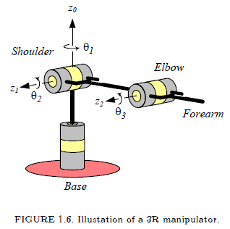
1.2. 3. Manipulator
The main body of a robot consisting of the links, joints, and other
structural elements. Is called the manipulator. A manipulator becomes a
Robot when the wrist and gripper are attached, and the control system is
Implemented.

Slide 19
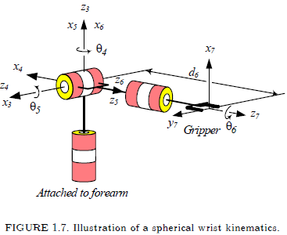
1.2. 4. Wrist
The joint in the kinematic chain of a robot between the forearm and end-
effector is referred to as the wrist.
Fig 1.7 shows a schematic illustration of a spherical wrist, which is a
mechanism.
The manipulator will possess three degrees-of- freedom ( DOF ) for position, which are produced by possessing three joints in the arm

Slide 20
1.2. 5. End-effector
The end-effector is the part mounted on the last link to do the required
job of the robot.
The simplest end-effector is a gripper, which is usually capable of only
two actions: opening and closing.
The wrist and end-effector assembly is also called a hand.
1.2. 6. Actuators
Actuators are drivers acting as the muscles of robots to change their
configuration. The actuators provide power to act.
1.2. 7. Sensors
The elements used for detecting and collecting information about
internal and environmental states are sensors.
1.2.8. Controller (processor and software)
Information role, which consists of collecting and processing the info-
mation provided by the robot’s sensors
2. Decision role, which consists of planning the geometric motion.
3. Communication role, which consists of organizing the information
Between the robot and its environment.

Slide 21
1.3. Robot Classifications
The Japanese Industrial Robot Association : 6 different classes.
The Robotics Institute of America(RIA) considers classes 3-6.
The Association Rrancaise de Robotique combines classes 2. 3, and 4.
Class 1: Manual handling devices: A device with multi degrees of freedom;
that is actuated by an operator.
Class 2: Fixed sequence robot: A device that performs the successive
Stages of a task according to a predetermined and fixed program.
Class 3: Variable sequence robot : // but programmable method.
Class 4: Playback robot: A human operator performs the task manually
by leading the robot, which records the motions for later playback. The
Robot repeats the same motions according to the recorded information.
Class 5: Numerical control robot: The operator supplies the robot with
a motion program rather than teaching it the task manually.
Class 6: Intelligent robot: A robot with the ability to understand its
environment and the ability to successfully complete a task despite changes in the surrounding conditions under which it is to be performed

Slide 22

1.3. 1. Geometry
A serial of open-loop manipulator: does not make a loop chain.
A parallel or closed-loop manipulator: makes a loop chain
A hybrid manipulator: both open and closed-loop chains.
The joint can be either revolute (R) or prismatic(P).
Most industrial manipulators have six DOF.
The axes of two adjacent joints can be parallel (||), orthogonal
or perpendicular .

Slide 23
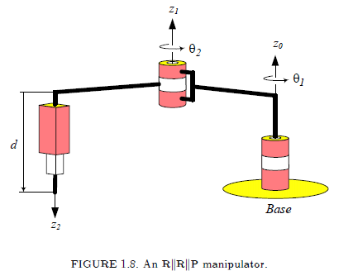
The SCARA arm ( Selective Complaint Articulated Robot for
Assembly) is a popular manipulator

Slide 24
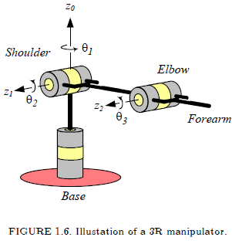
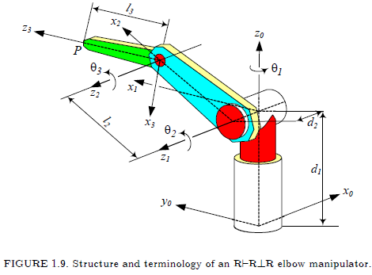
It is called elbow, revolute, articulated, or anthropomorphic. It is suitable
configuration for industrial robots. Almost 25% of industrial robots,
PUMA for instance, are made of this kind.

Slide 25
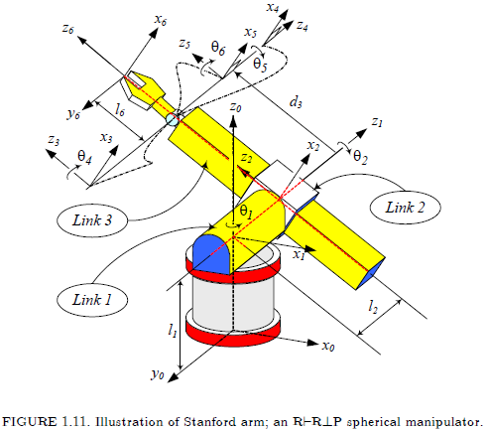
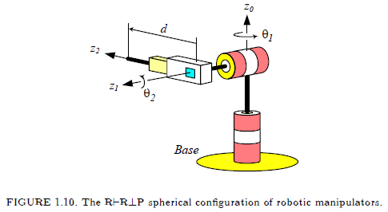
The spherical configuration is a suitable configuration for small robots.
Almost 15% of industrial robots, Stanford arm for instance, are made
of this configuration.

Slide 26
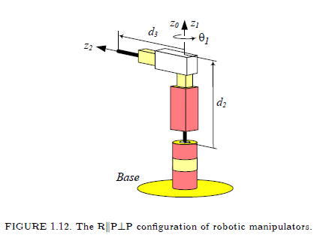
The cylindrical configuration is a suitable configuration for medium load
capacity robots. Almost 45% of industrial robots are made of this kind.

Slide 27
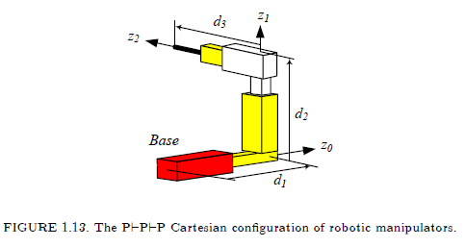
The Cartesian configuration is suitable for heavy load capacity and large
robots. Almost 15% of industrial robots are made of this configuration.

Slide 28
1.3. 2. Workspace
The workspace of a manipulator is the total volume of space the end-effector can reach. The workspace is broken into a reachable workspace
and a dexterous workspace.
The reachable workspace is the volume of space within which every
point is reachable by the end-effector in at least one orientation.
The dexterous workspace is the volume of space within which every
point can be reached by the end-effector in all possible orientation.
1.3.3. Actuation
  Actuators translate power into motion.
  Robots are typically actuated electrically, hydraulically,
  or pneumatically.
1.3.4. Control
Servo (closed loop control) robots.
  the point-to-point robots : control points, no control on the path.
  the continuous path robots : control the entire path of the end-effector
- Non servo (open-loop control) robots : primarily used for materials
transfer.

Slide 29
1. 4. Introduction to Robot’s Kinematics, Dynamics, and Control
Forward kinematics:
  To determine the position and orientation of the end-effector. (gripper or hand)
  All the joint variable (angle and/or distance) and the linkage parameters are known.
  Using 4 X 4 homogeneous transformation matrix.
Inverse kinematics:
  To determine the joint variables (angle and/or distance)
  the particular point with the specific orientation of the end-effector( gripper or hand) is known.
Denavit-Hartenberg ( D-H) method:
  A simple and standard way of modeling robot links and joints.
  Systematically determine 4 X 4 transformation matrix

Slide 30
Forward kinematics:
  Given joint angles (l1, l2, ..,ln 1, 2, …, n)
  determine the end-effector (position & orientation)
Inverse kinematics:
  To determine the joint variables (angle and/or distance)
  the particular point with the specific orientation of the end-effector( gripper or hand) is known.

Slide 31
1.4. Introduction to Robot’s Kinematics, Dynamics, and Control
Dynamics is the study of systems that undergo changes of state as time evolves. Derivation of the equations of motion for the system is the main step in dynamic analysis of the system.
They can be used for computer simulation of the robot’s motion, design of suitable control equations, and evaluation of the dynamic performance of the design.
The robot control comprises three computational problems:
Determination of the trajectory in Cartesian coordinate space.
Transformation of the Cartesian trajectory into equivalent joint coordinate space, and
Generation of the motor torque commands to realize the trajectory.

Slide 32
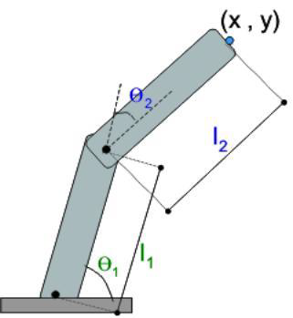
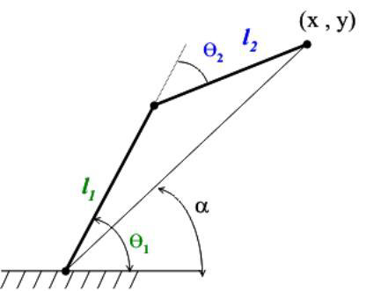
An Example
2-link manipulator
x = l1cos 1 + l2cos(1+ 2)
y = l1sin 1 + l2sin(1+ 2)
Forward Kinematics : Given the
joint variable (1, 2),
find the end-effector position(x, y)
Inverse Kinematics: Given the end-
effector position(x, y).
find the joint variable (1, 2)

Slide 33
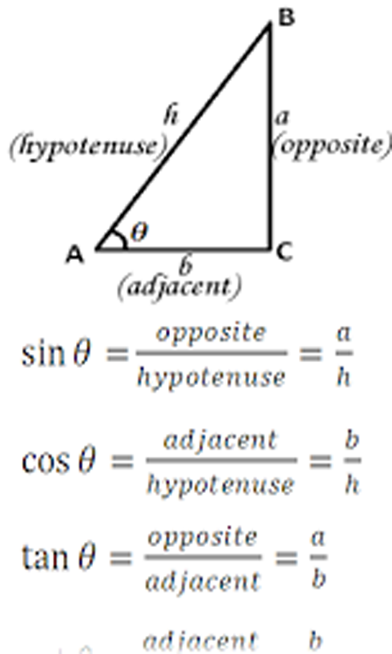
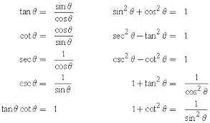
Basic Trigonometry

Slide 34
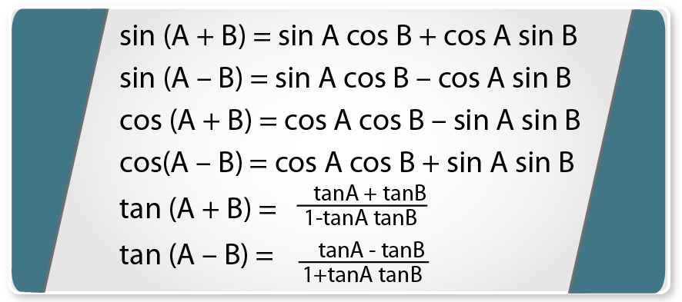
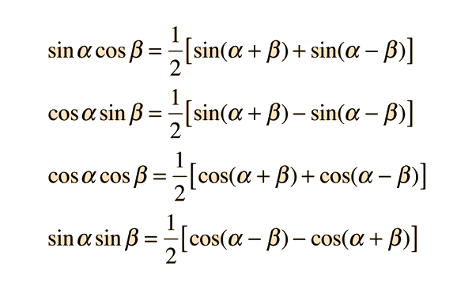
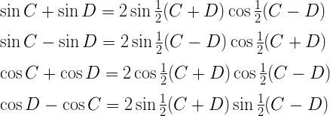
Formula for trigonometric ratios of compound angles

Slide 35
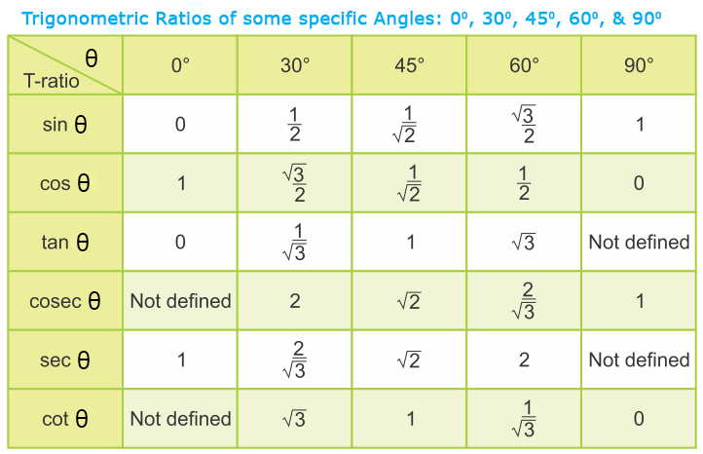
Example

Slide 36
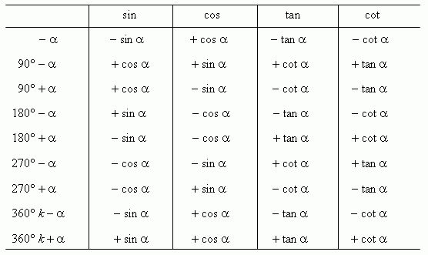
Example

Slide 37
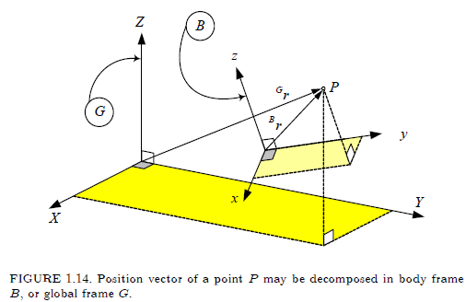
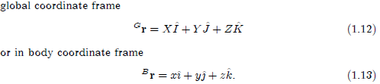
1.4.3 Reference Frame and Coordinate System

Slide 38
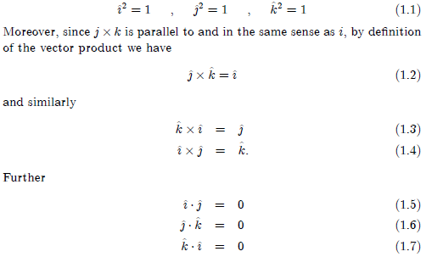
1.4.2 Unit Vector

Slide 39
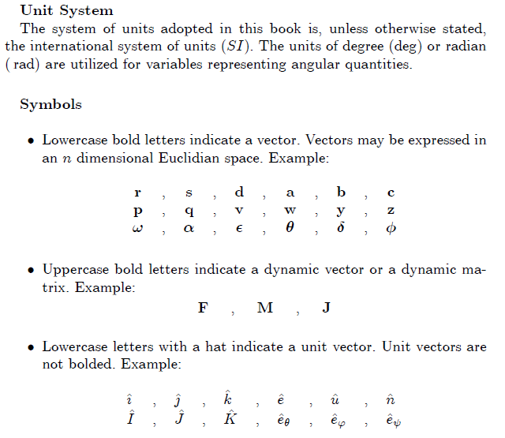
California State University, San Bernardino
School of Computer Science and Engineering

Slide 40
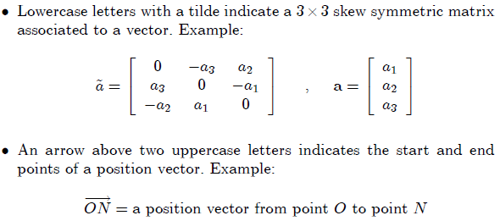
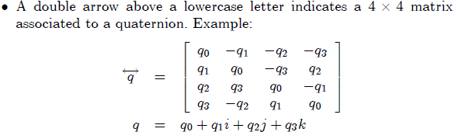
California State University, San Bernardino
School of Computer Science and Engineering

Slide 41
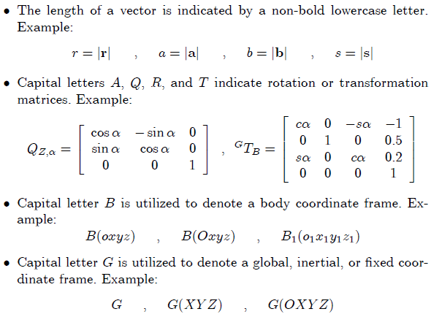
California State University, San Bernardino
School of Computer Science and Engineering

Slide 42
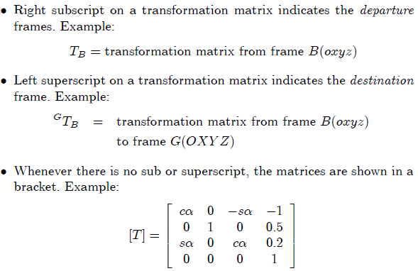
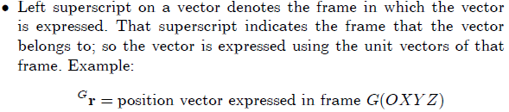
California State University, San Bernardino
School of Computer Science and Engineering

